Slide 1
LabChat
Hanna Schulze, Oliver Wagner
Cloud Computing WS 18/19

Slide 2
LabChat
Agenda
Sequence Diagram
Component Diagram
Node Modules, jQuery Plugins etc.
Features
Live Demo
Hanna Schulze, Oliver Wagner //Cloud Computing WS 18/19

Slide 3
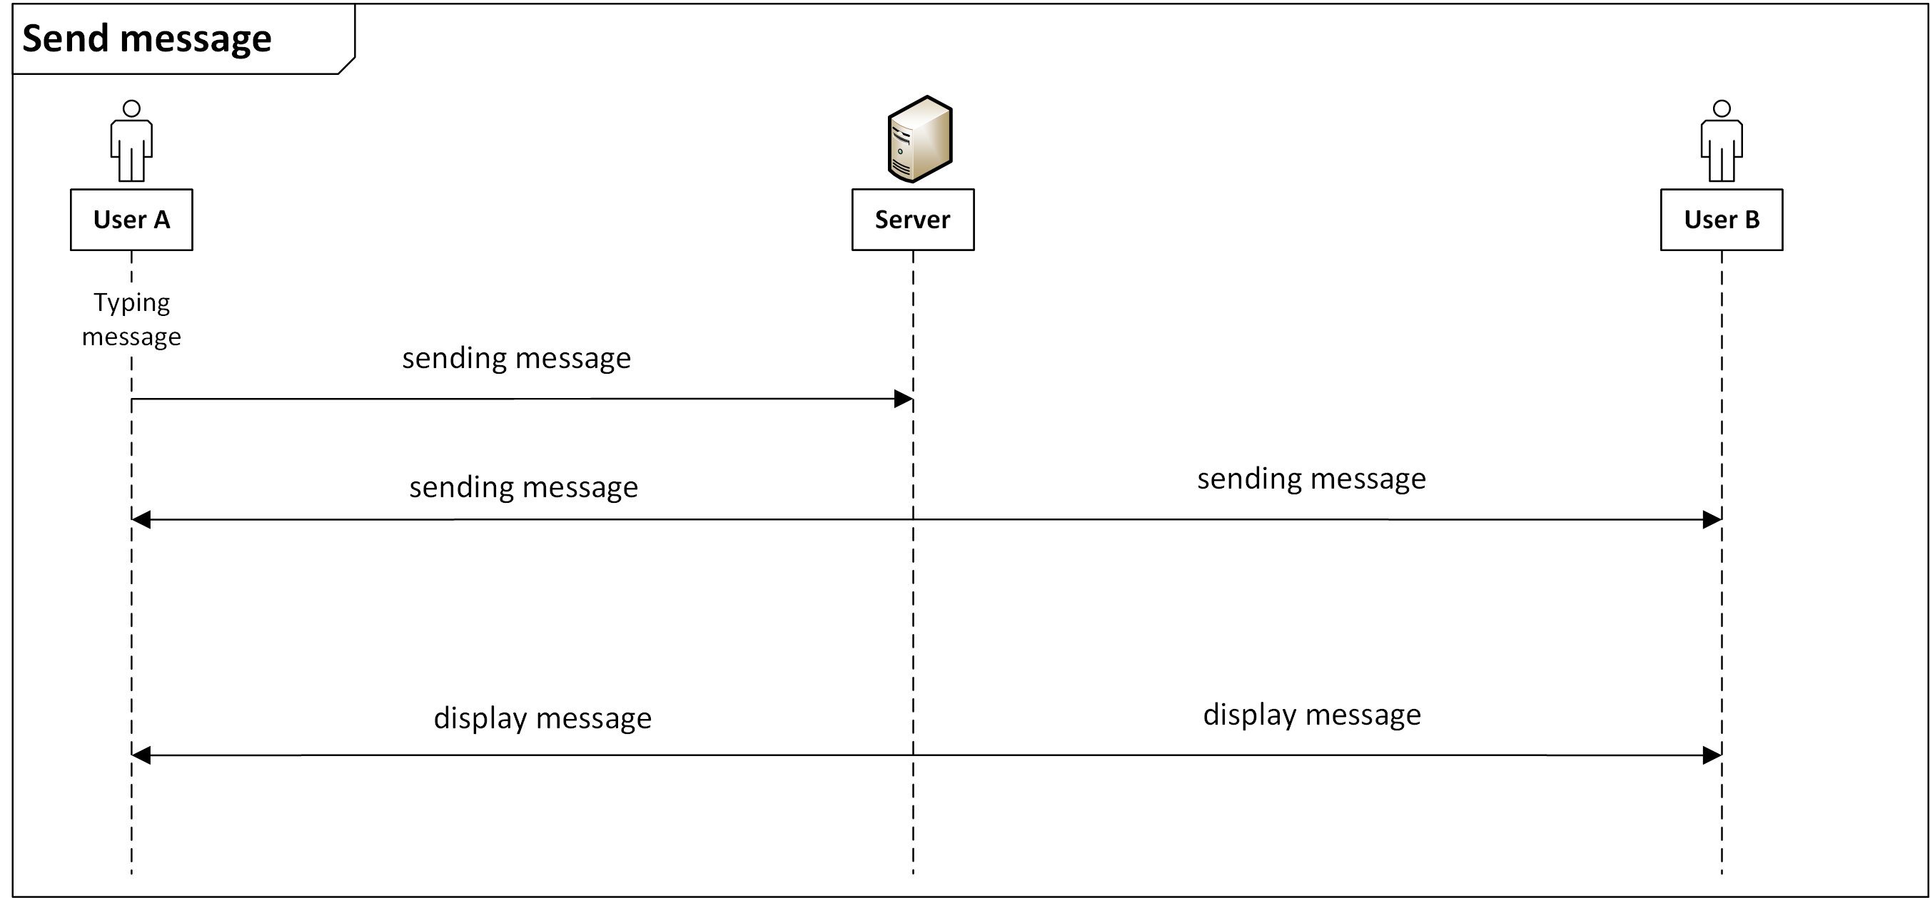
LabChat
Sequence Diagram
Hanna Schulze, Oliver Wagner //Cloud Computing WS 18/19

Slide 4
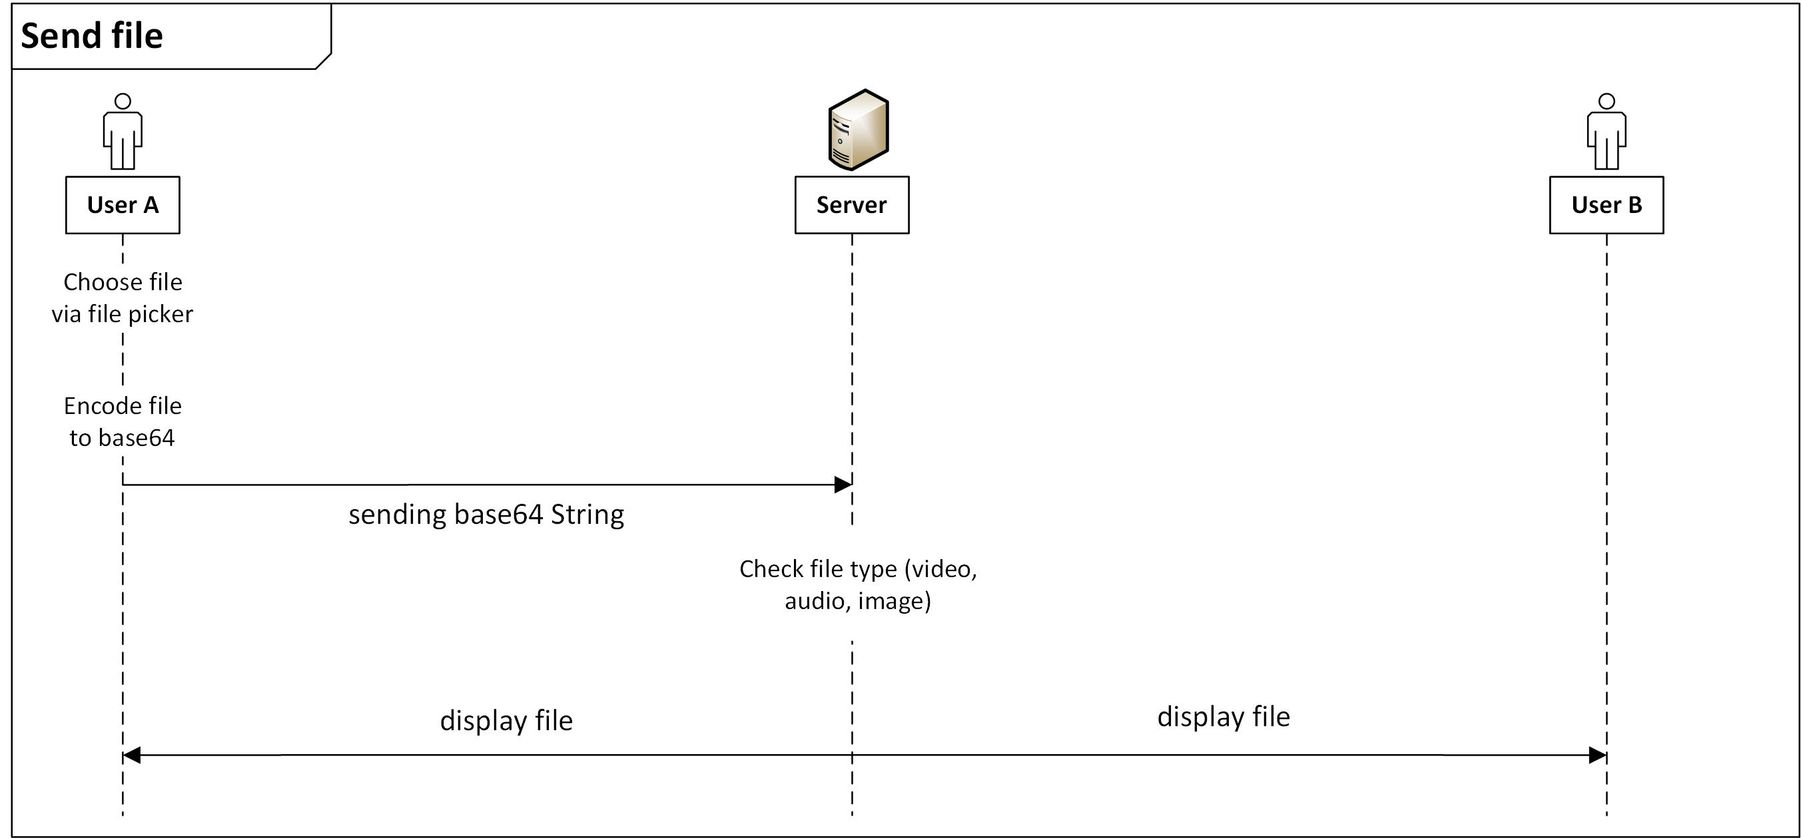
LabChat
Sequence Diagram
Hanna Schulze, Oliver Wagner //Cloud Computing WS 18/19

Slide 5
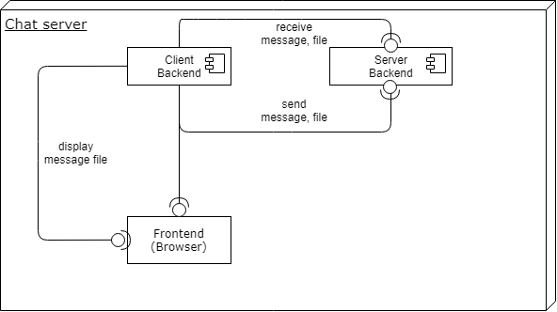
LabChat
Component Diagram
Hanna Schulze, Oliver Wagner //Cloud Computing WS 18/19

Slide 6
LabChat
Node Modules
express https://www.npmjs.com/package/express
dateformat https://www.npmjs.com/package/dateformat
fs https://nodejs.org/api/fs.html
https https://nodejs.org/api/https.html
socket.io https://socket.io
Hanna Schulze, Oliver Wagner //Cloud Computing WS 18/19

Slide 7
LabChat
Frameworks & jQuery Plugins
Bootstrap https://getbootstrap.com/
Fontawesome https://fontawesome.com/
CSS Emoticons https://os.alfajango.com/css-emoticons/
Hanna Schulze, Oliver Wagner //Cloud Computing WS 18/19

Slide 8
LabChat
Live Demo
https://localhost:3001
Hanna Schulze, Oliver Wagner //Cloud Computing WS 18/19

